Slide 1
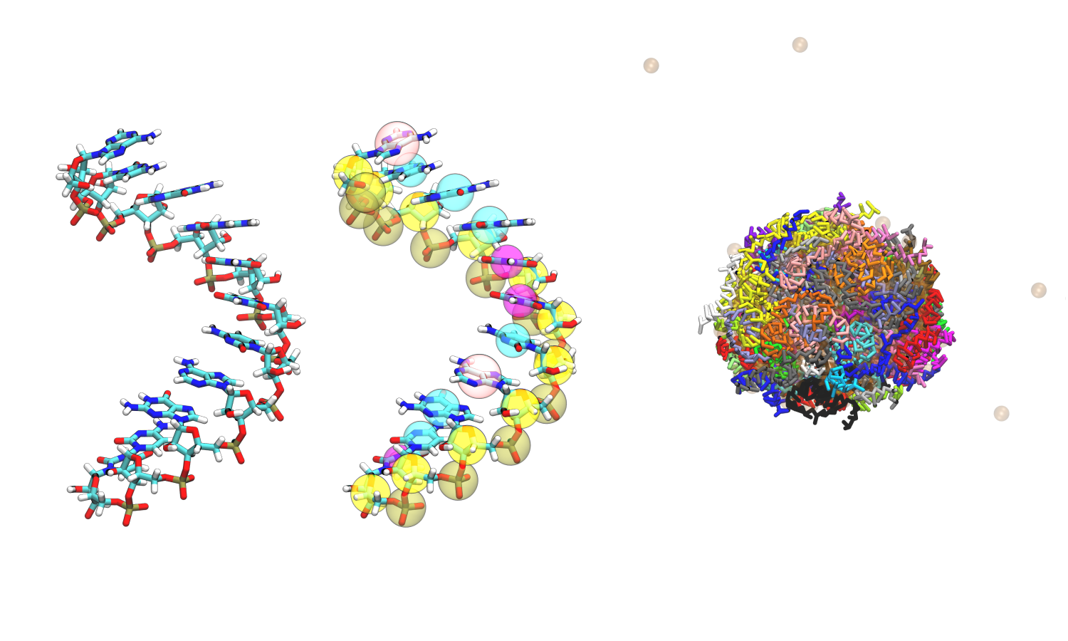
Coarse-grained Simulation of ssRNA
Structural Ensemble, Ion Atmosphere, Phase Separation
Peter Zhang
MDAnalysis UGM 2025
Department of Chemistry
University at Buffalo
November 12, 2025

Slide 2
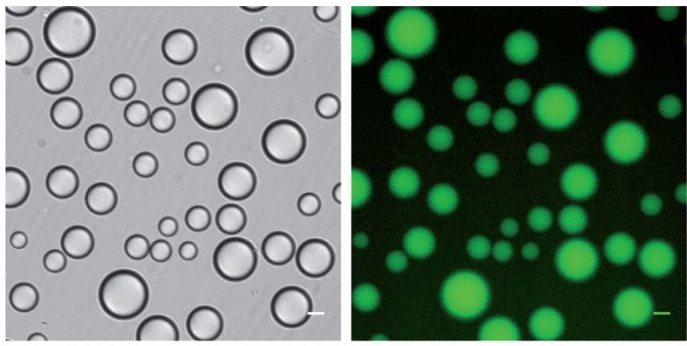
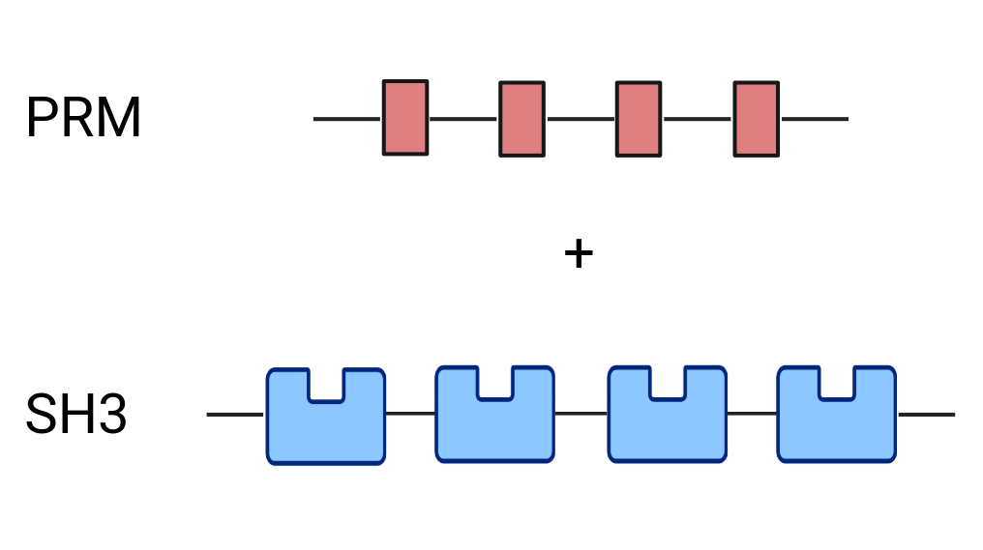
Biomolecular Condensates Organize Cellular Biochemistry on Micron Scales
Scale bars, 20 μm
Li, Rosen, and colleagues. Nature 483, 336–340 (2012).

Slide 3
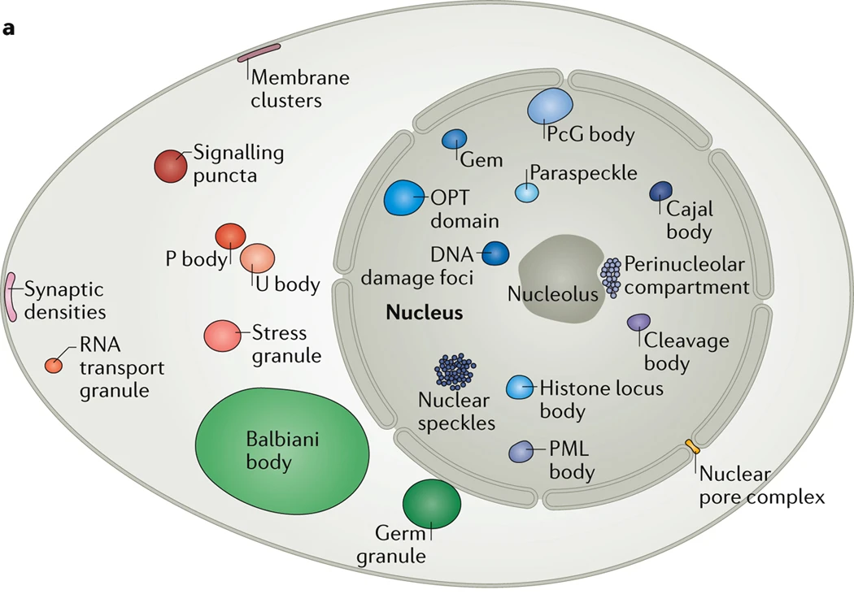
Multivalent Interactions Promote Phase Separation
Concentrate molecules without surrounding membrane
π-π interactions
Cation-anion interactions
Dipole-dipole
Cation-π interactions
Banani, Lee, Hyman, and Rosen Nat Rev Mol Cell Biol 18, 285–298 (2017)

Slide 4
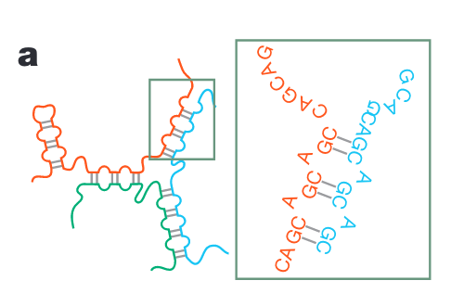
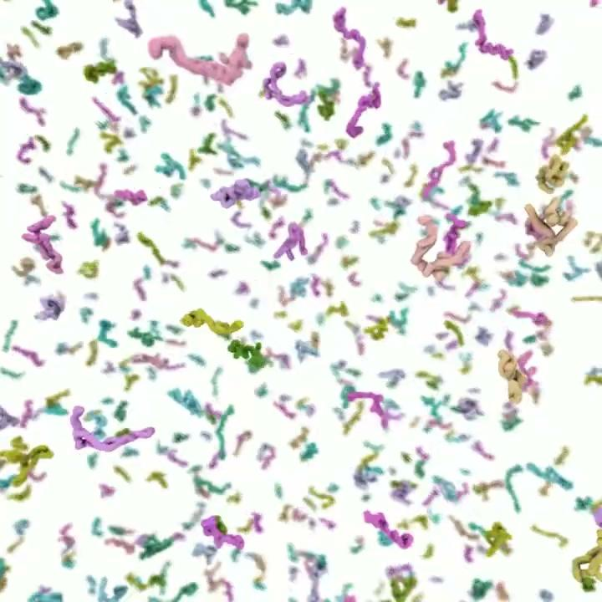
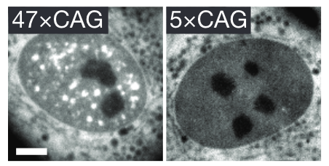
Multivalent Interactions Promote Phase Separation
Single-interaction site coarse-grained simulation
Jain and Vale. Nature 483, 336–340 (2012)
Nguyen, Hori, and Thirumalai. Nat. Chem. 14, 775–785 (2022)

Slide 5
What are the roles of Mg²⁺ in driving phase separation?

Slide 6
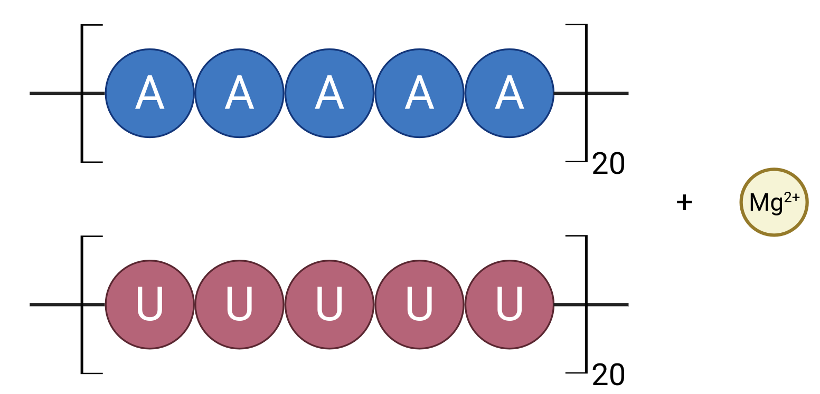
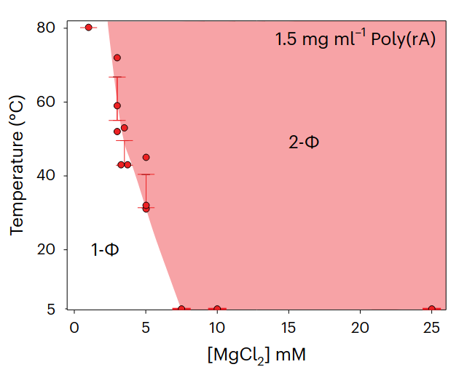
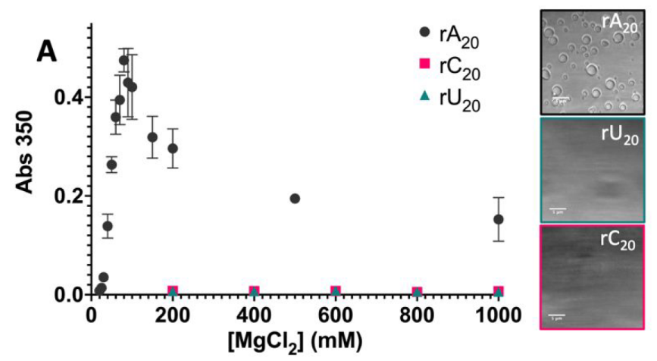
ssRNA Homopolymer Phase Separate with Mg²⁺
Lower Critical Solution Temperature (LCST)
Tom, Onuchic, and Deniz. J. Phys. Chem. B 126, 9715–9725 (2022)
Wadsworth, Banerjee and colleagues. Nat. Chem. 15, 1693-1704 (2023)

Slide 7
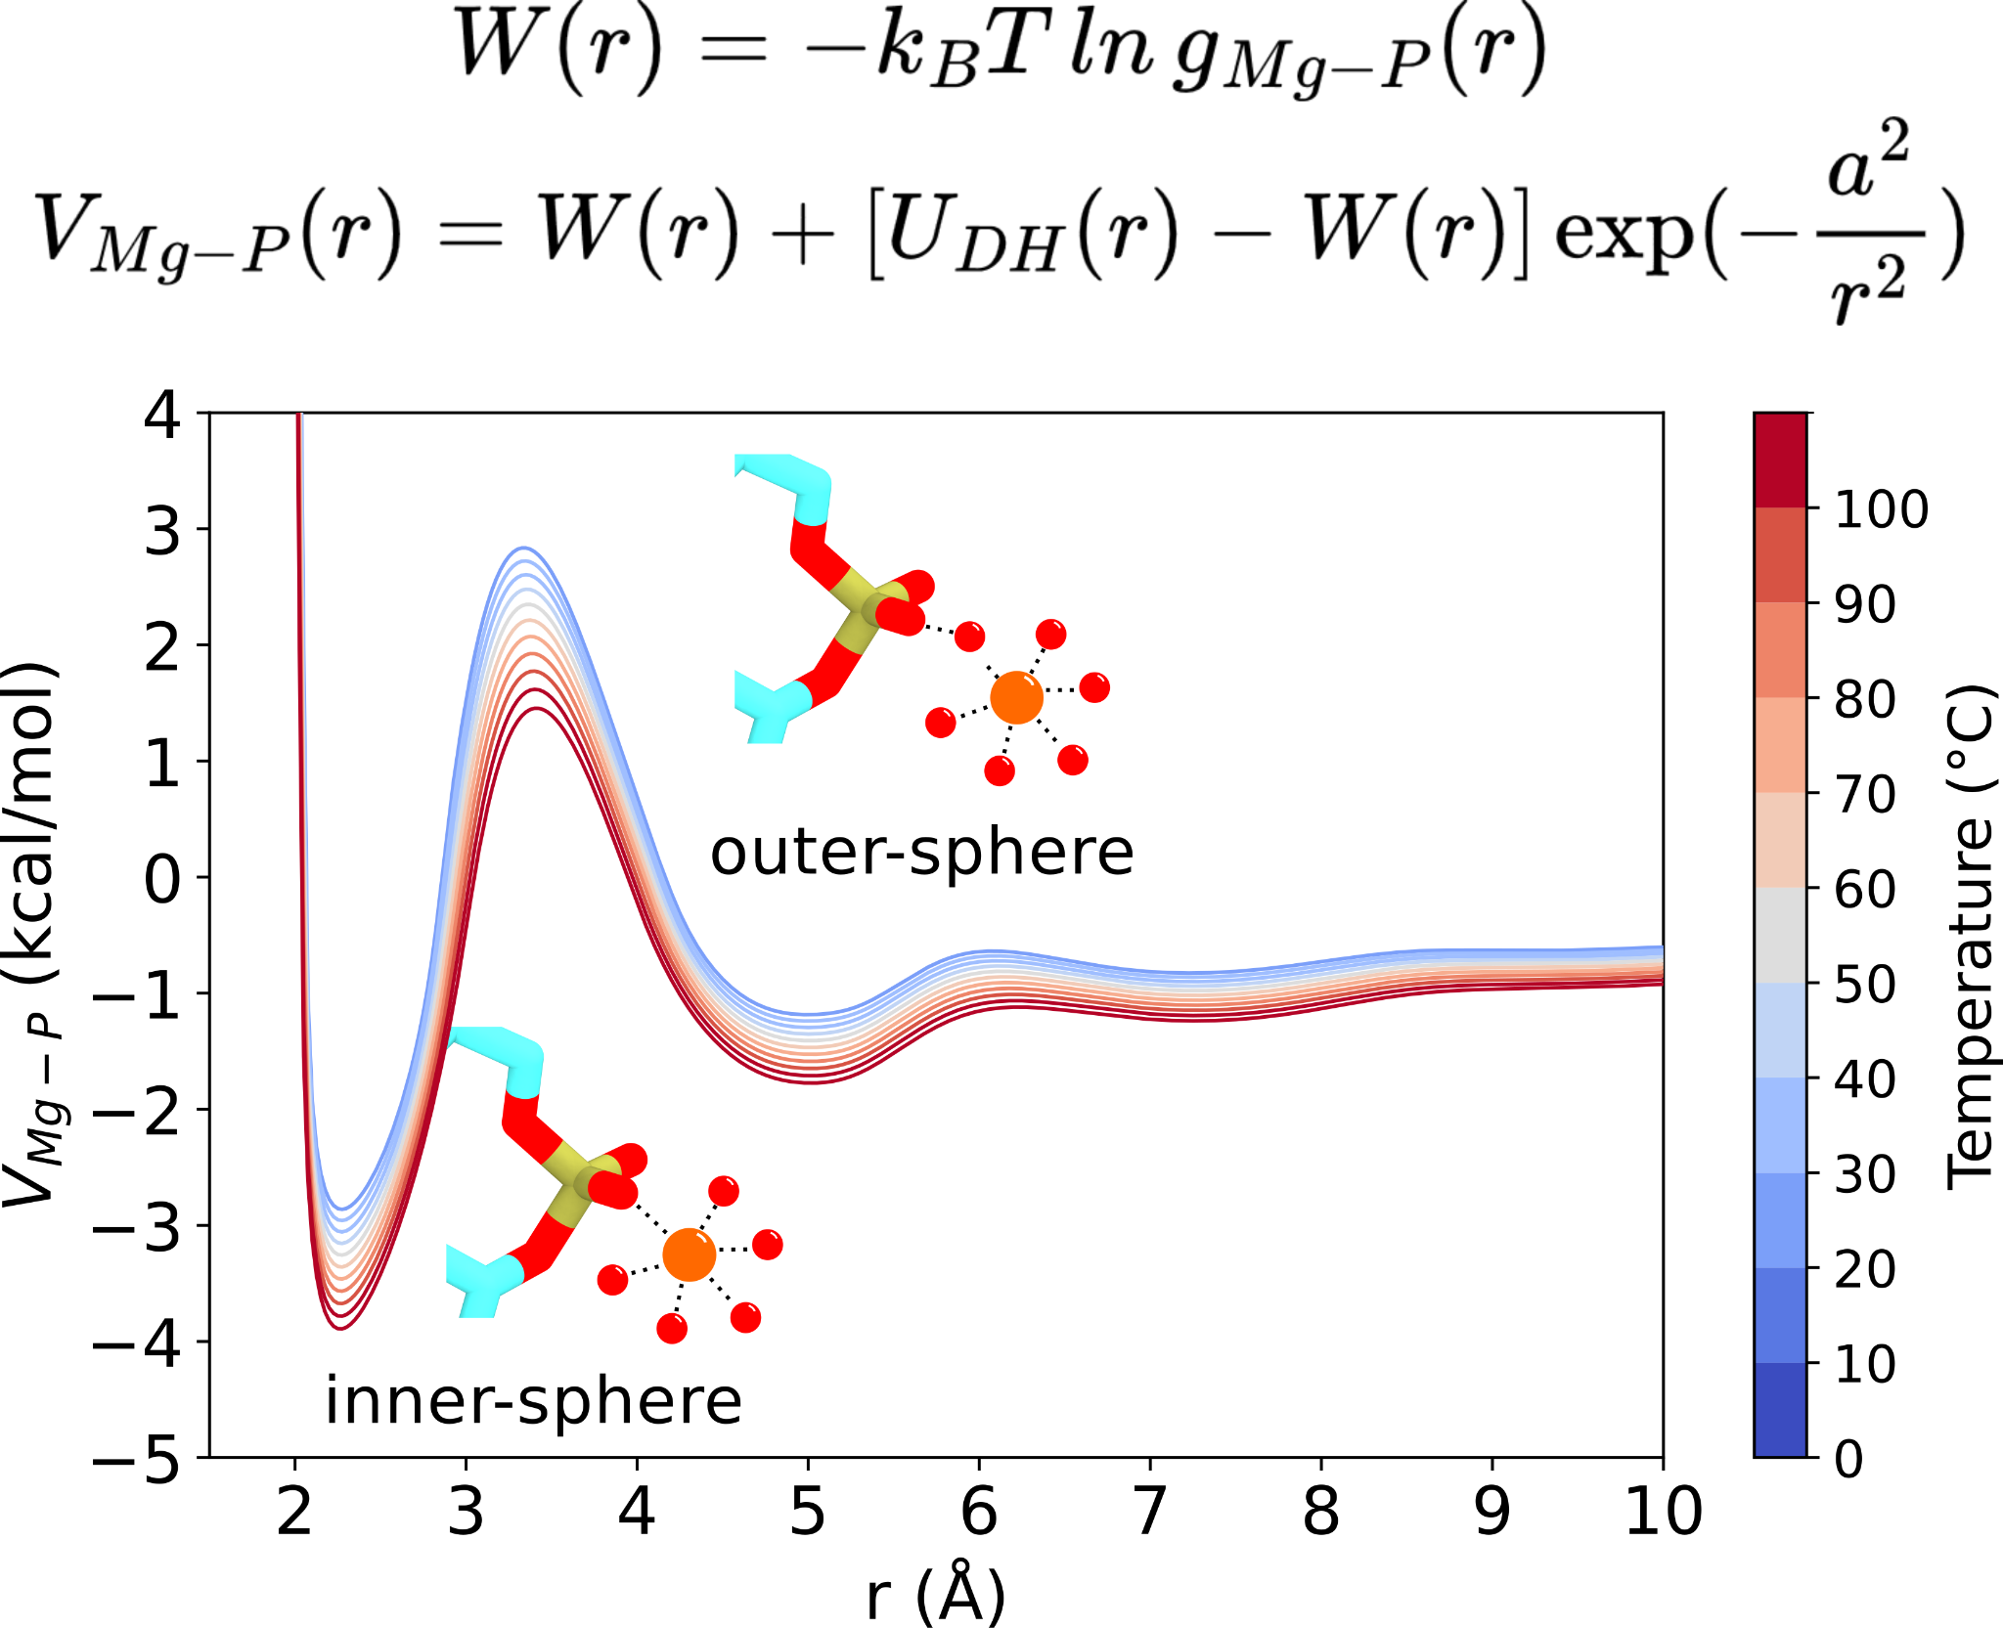
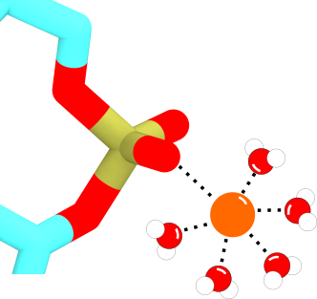
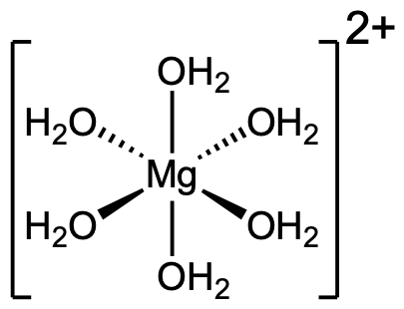
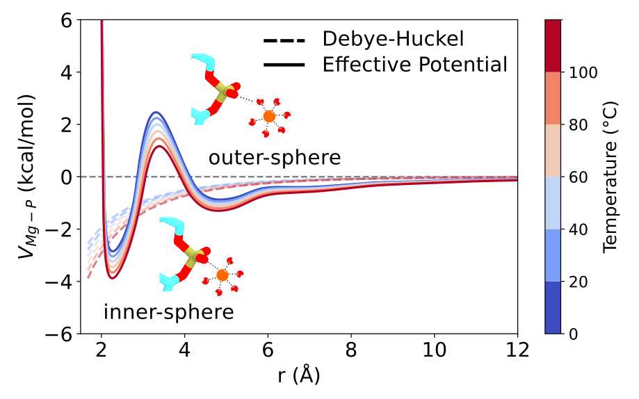
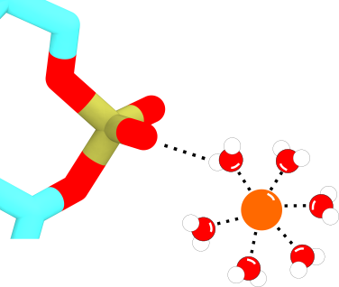
Effective Interaction Potential Between Mg and Phosphate
Neutralizing negatively charged phosphate backbone
inner-sphere
outer-sphere
Nguyen, Hori, and Thirumalai. PNAS 116, 21022–21030 (2019)

Slide 8
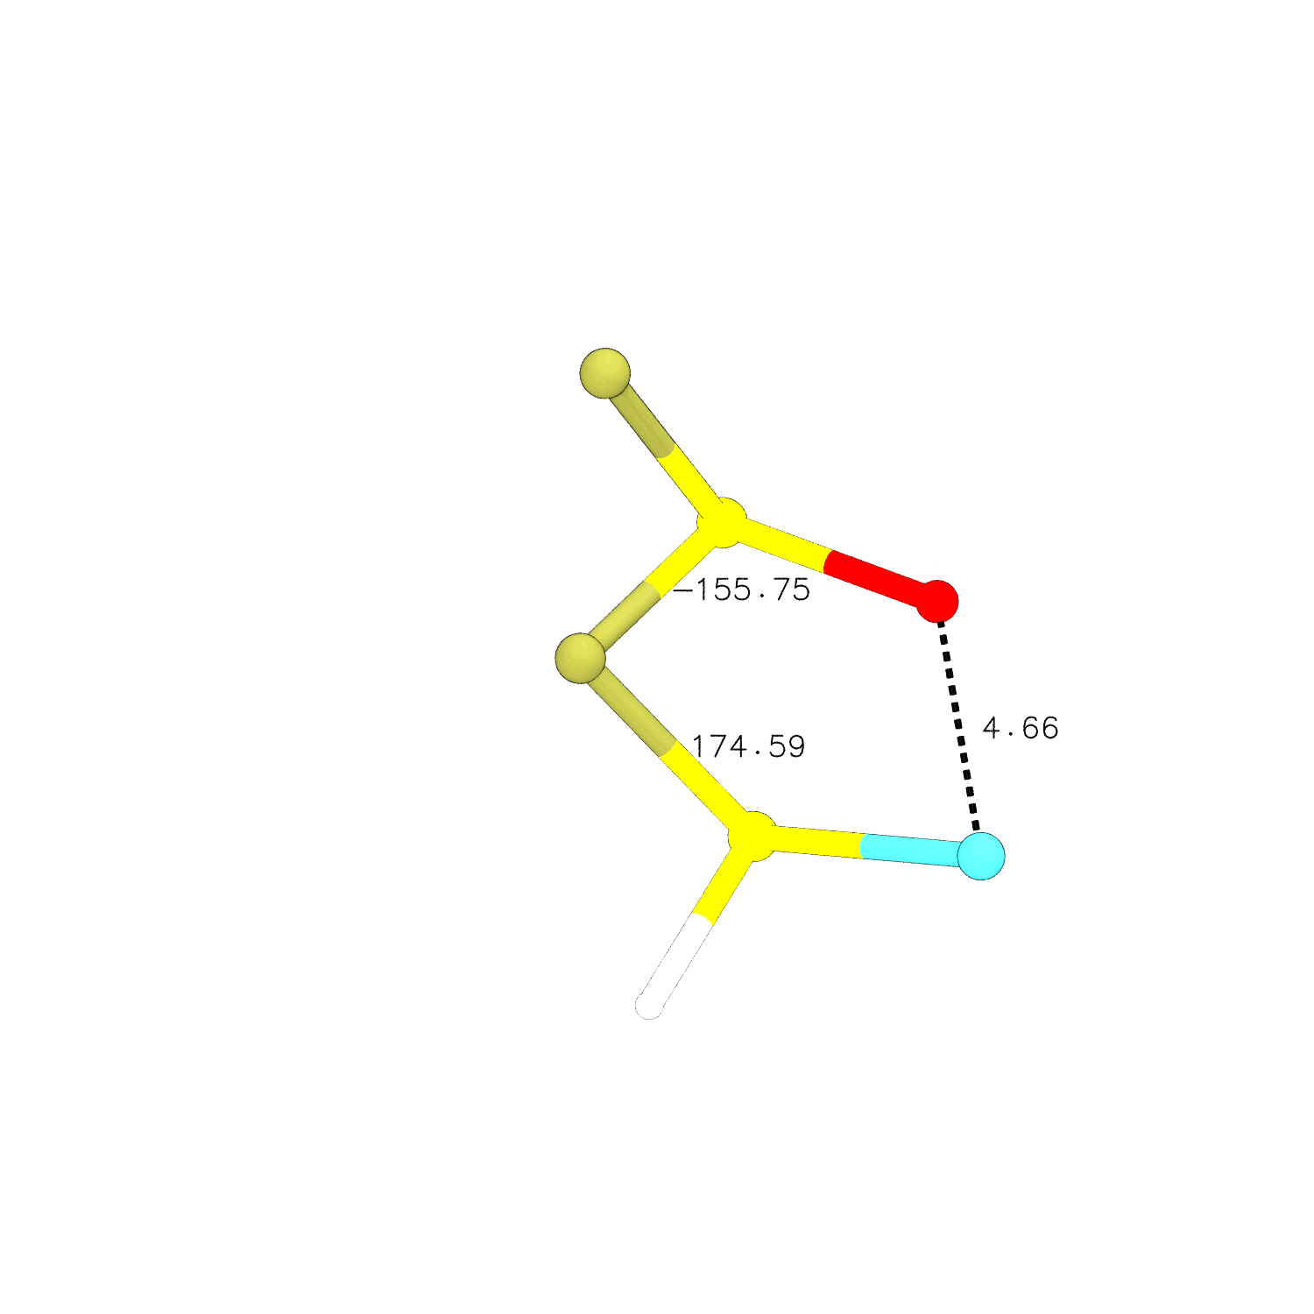
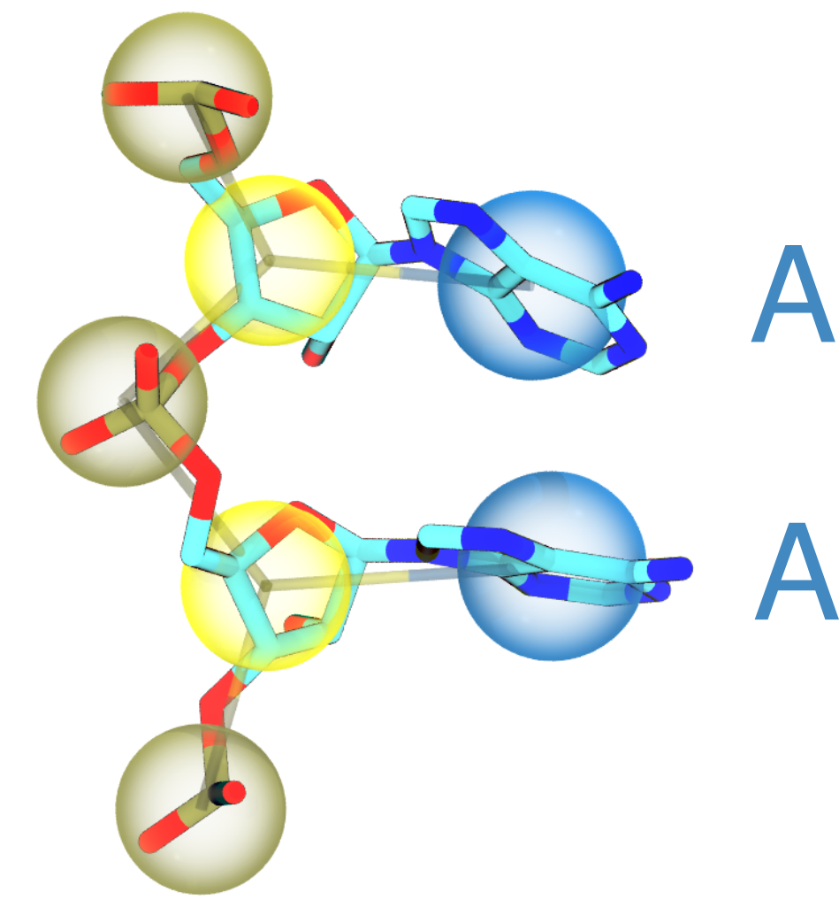
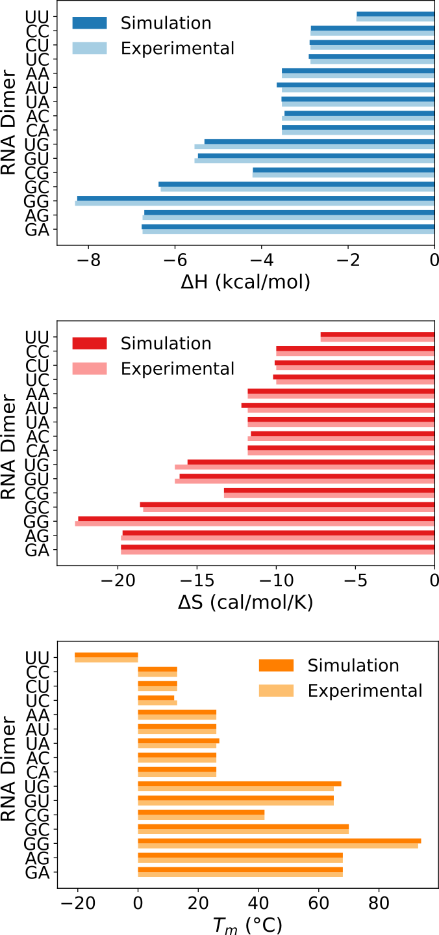
Base-base Stacking Stabilizes ssRNA Secondary Structure

Slide 9
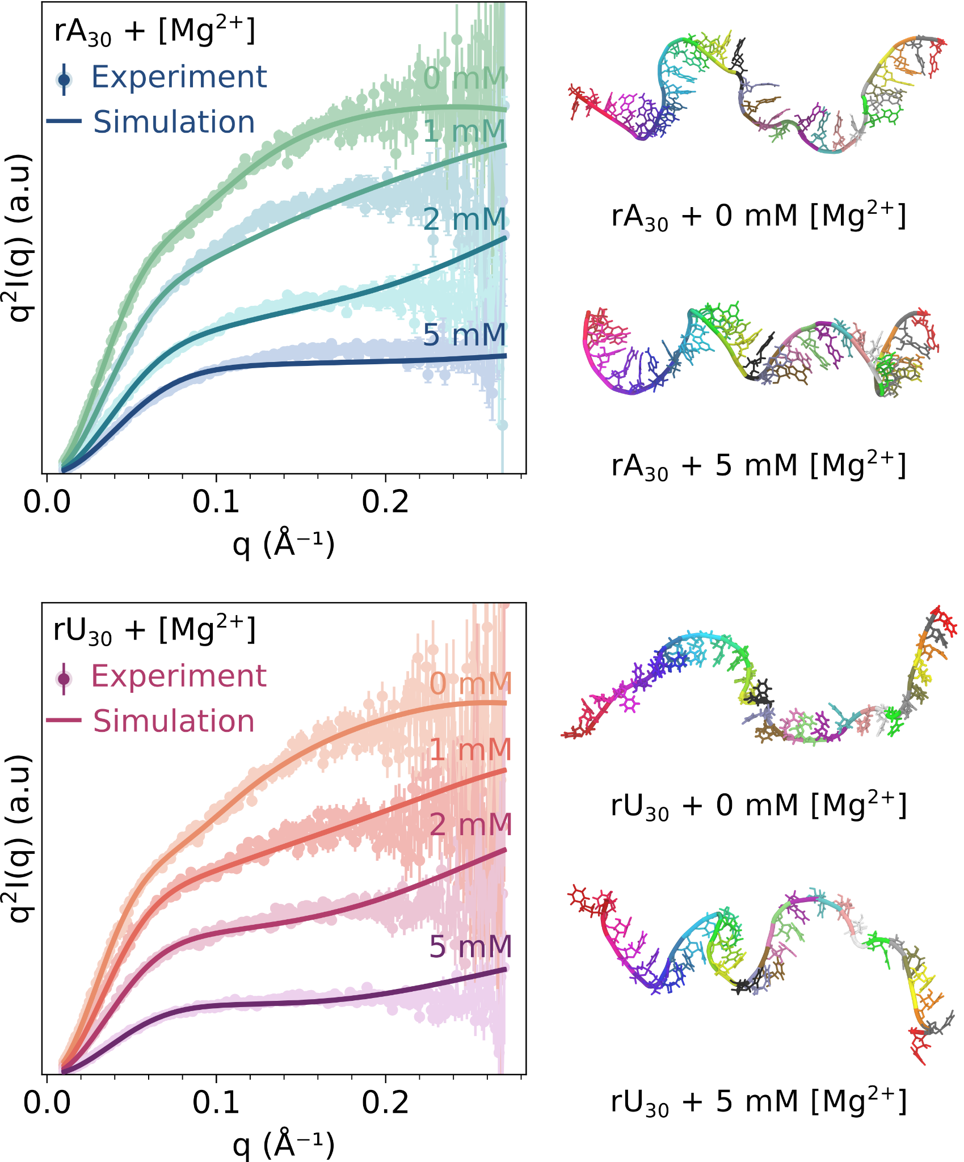
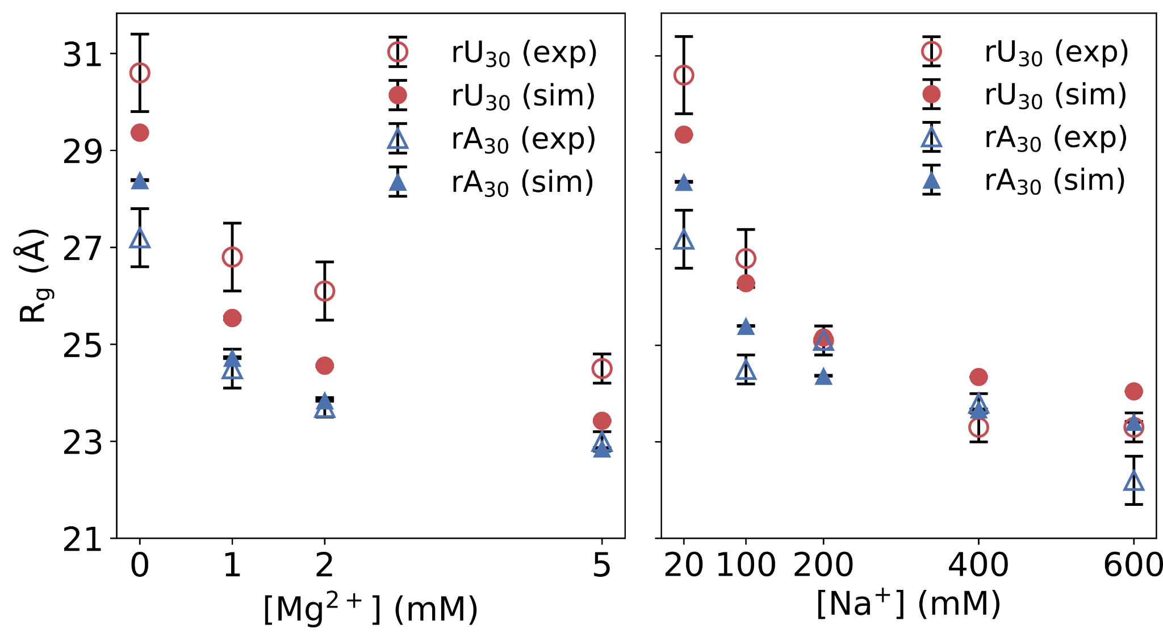
ssRNAs Compact in the Presence of Mg²⁺ and Na⁺

Slide 10
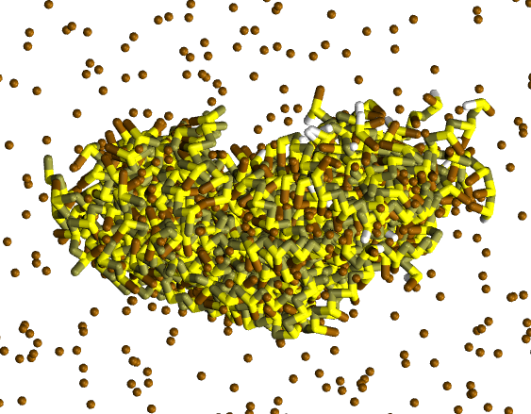
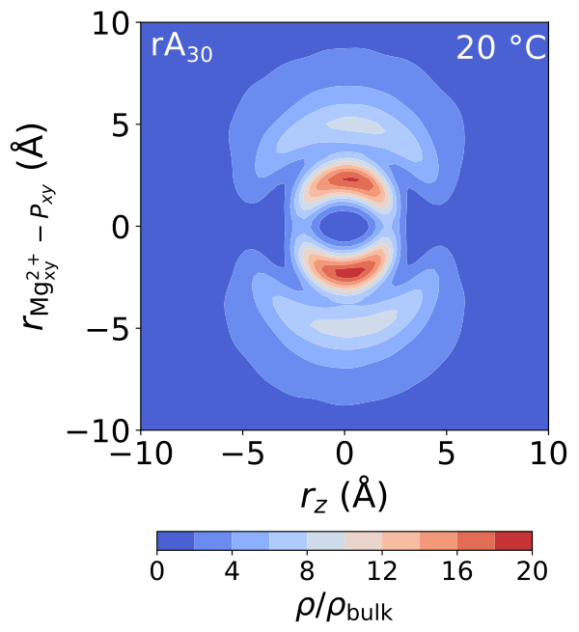
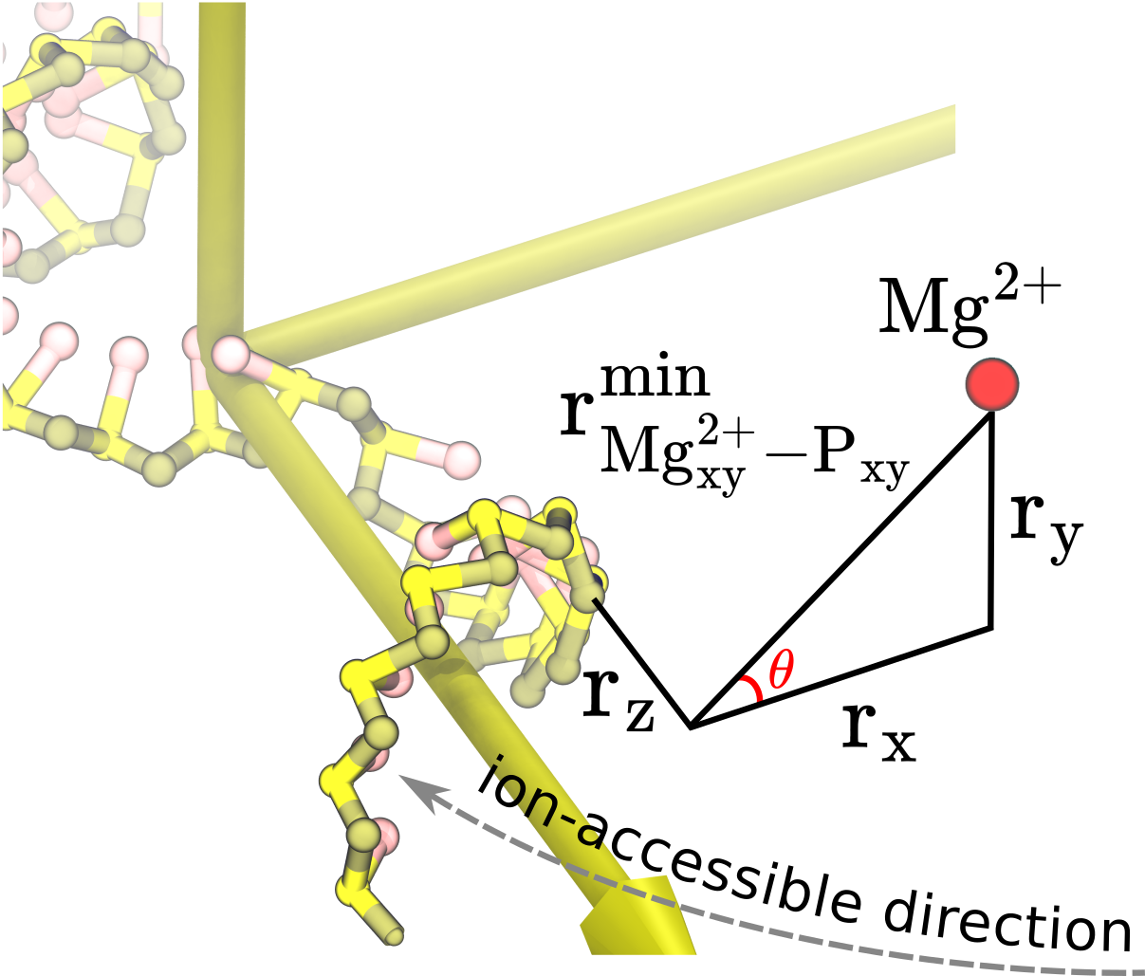
Helical Structure Induce Helical Ion Atmosphere
Outer-sphere
Inner-sphere
Inner-sphere
Outer-sphere

Slide 11
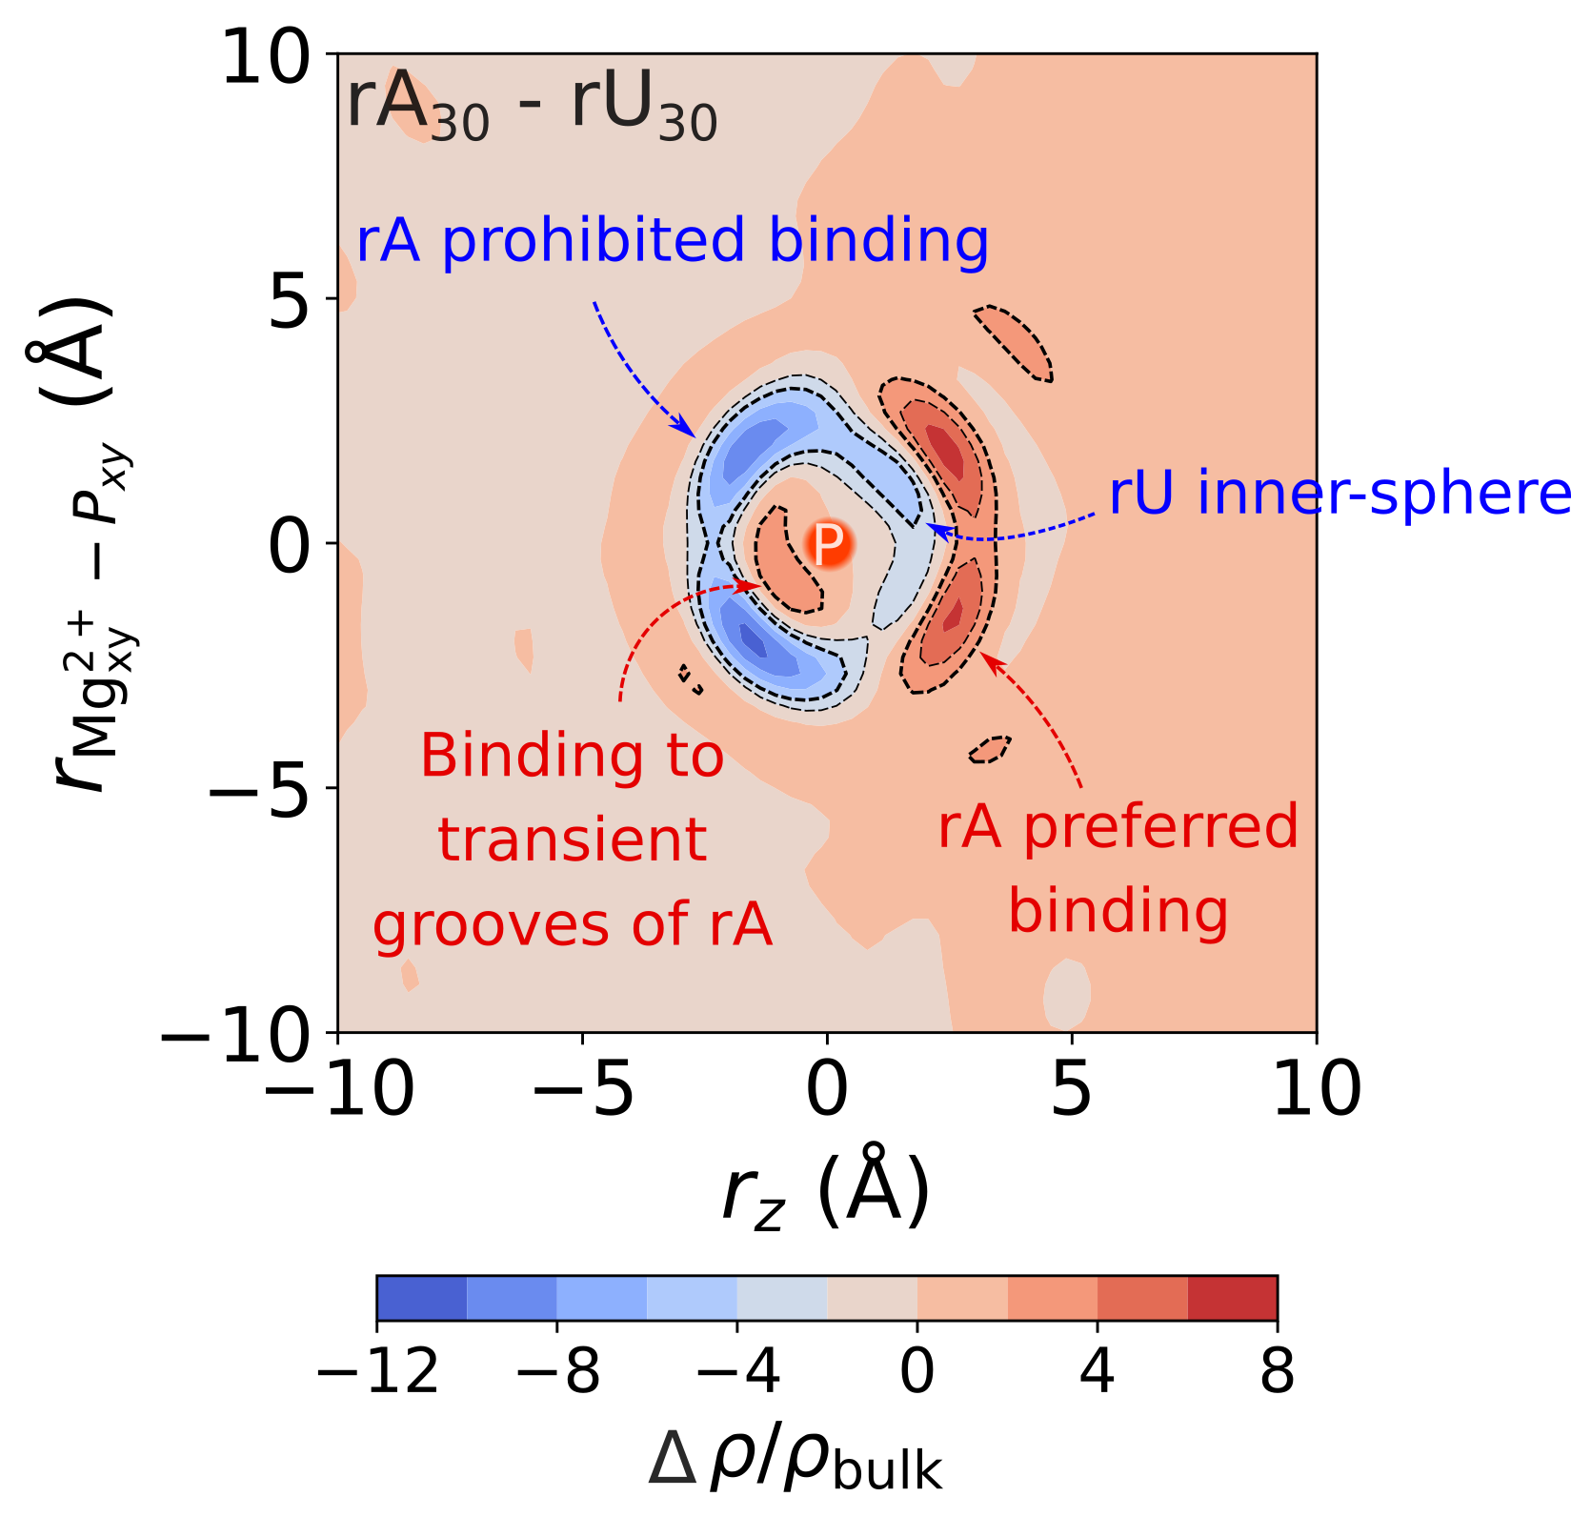
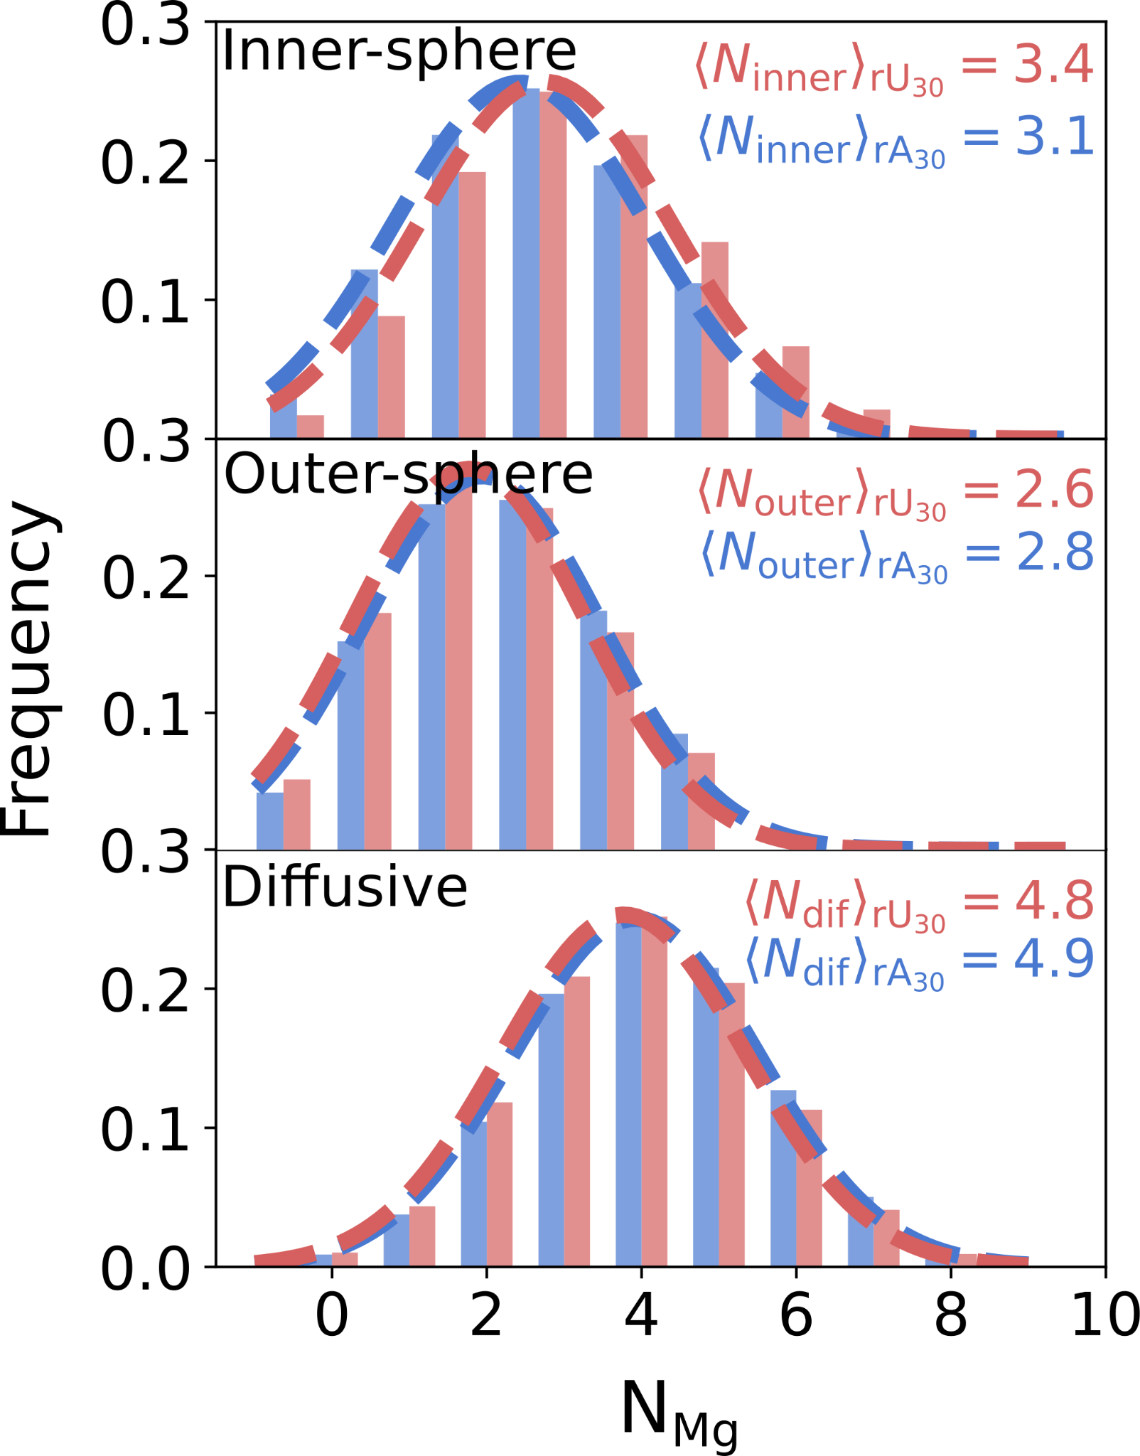
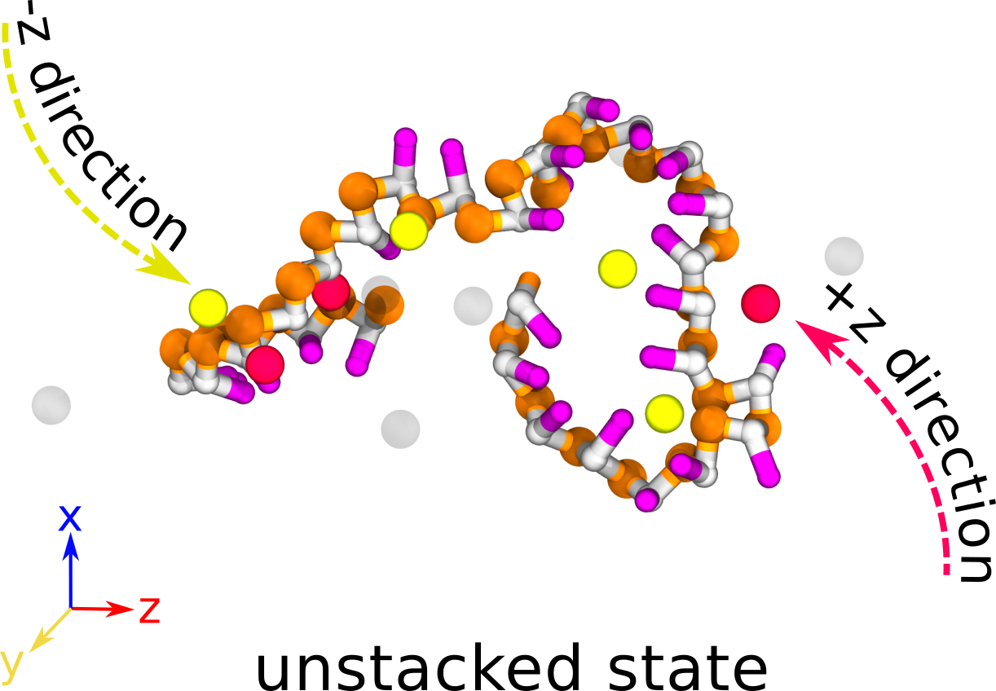
rU30 Attracts More Inner-sphere Mg²⁺
Sequence-dependent Mg²⁺ binding

Slide 12
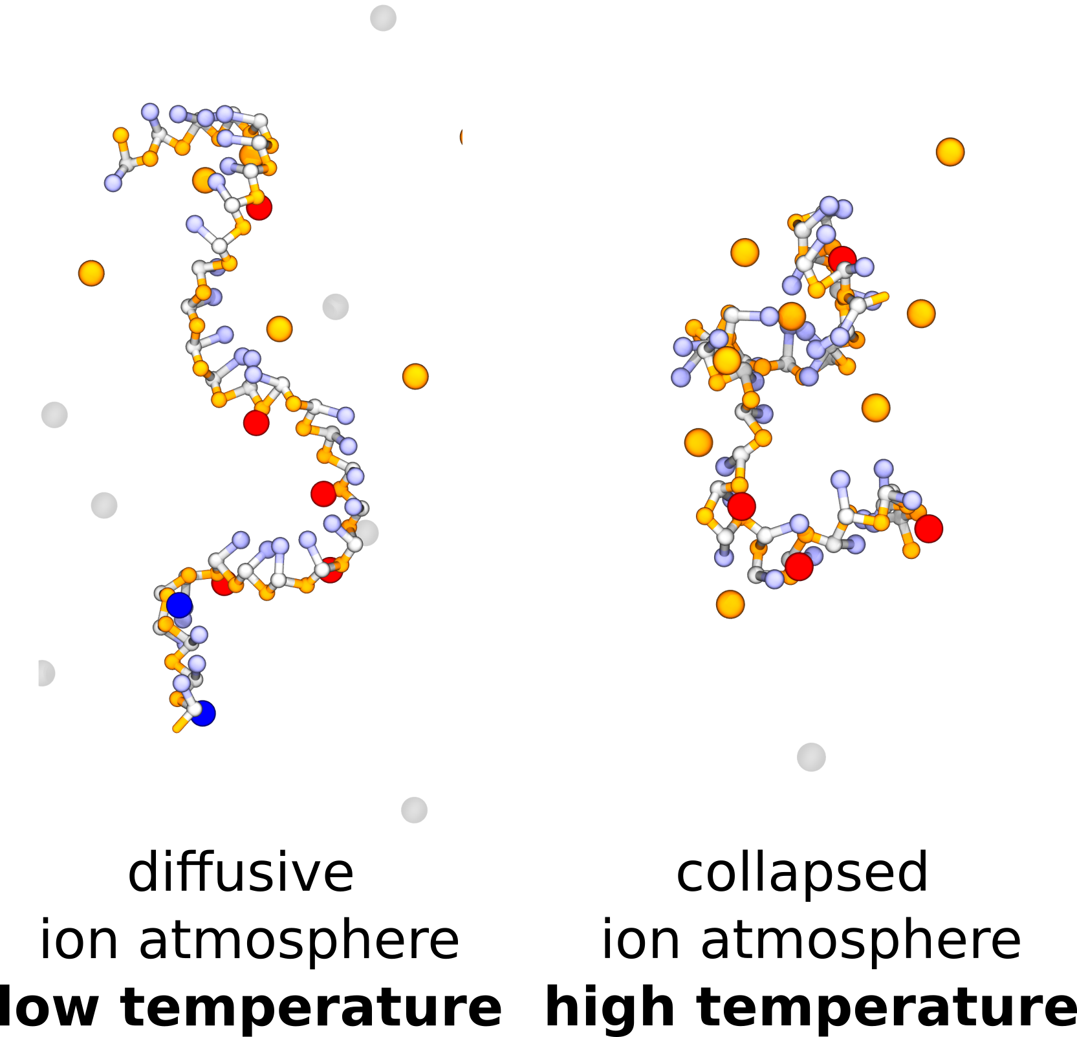
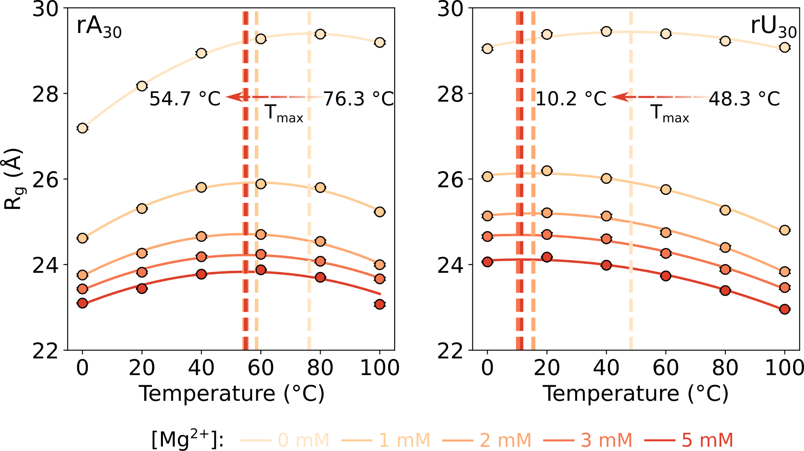
ssRNA Structures Collapse at High Temperature

Slide 13
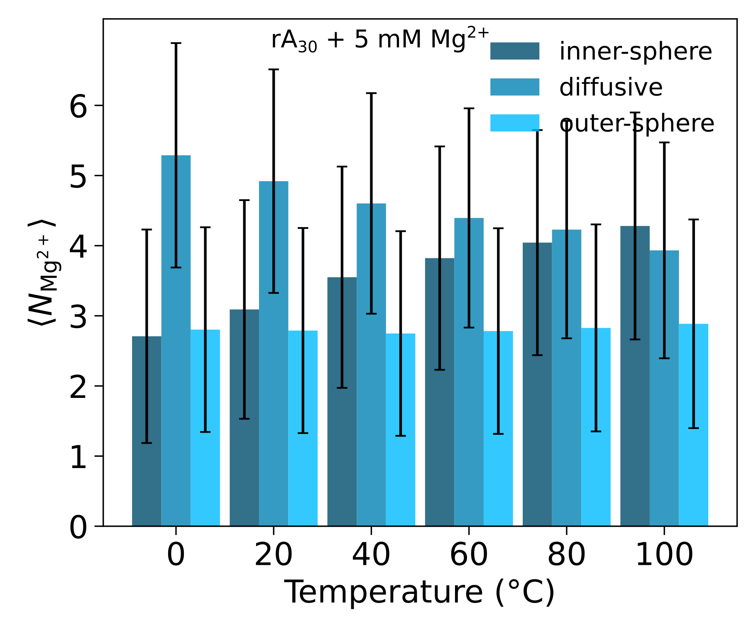
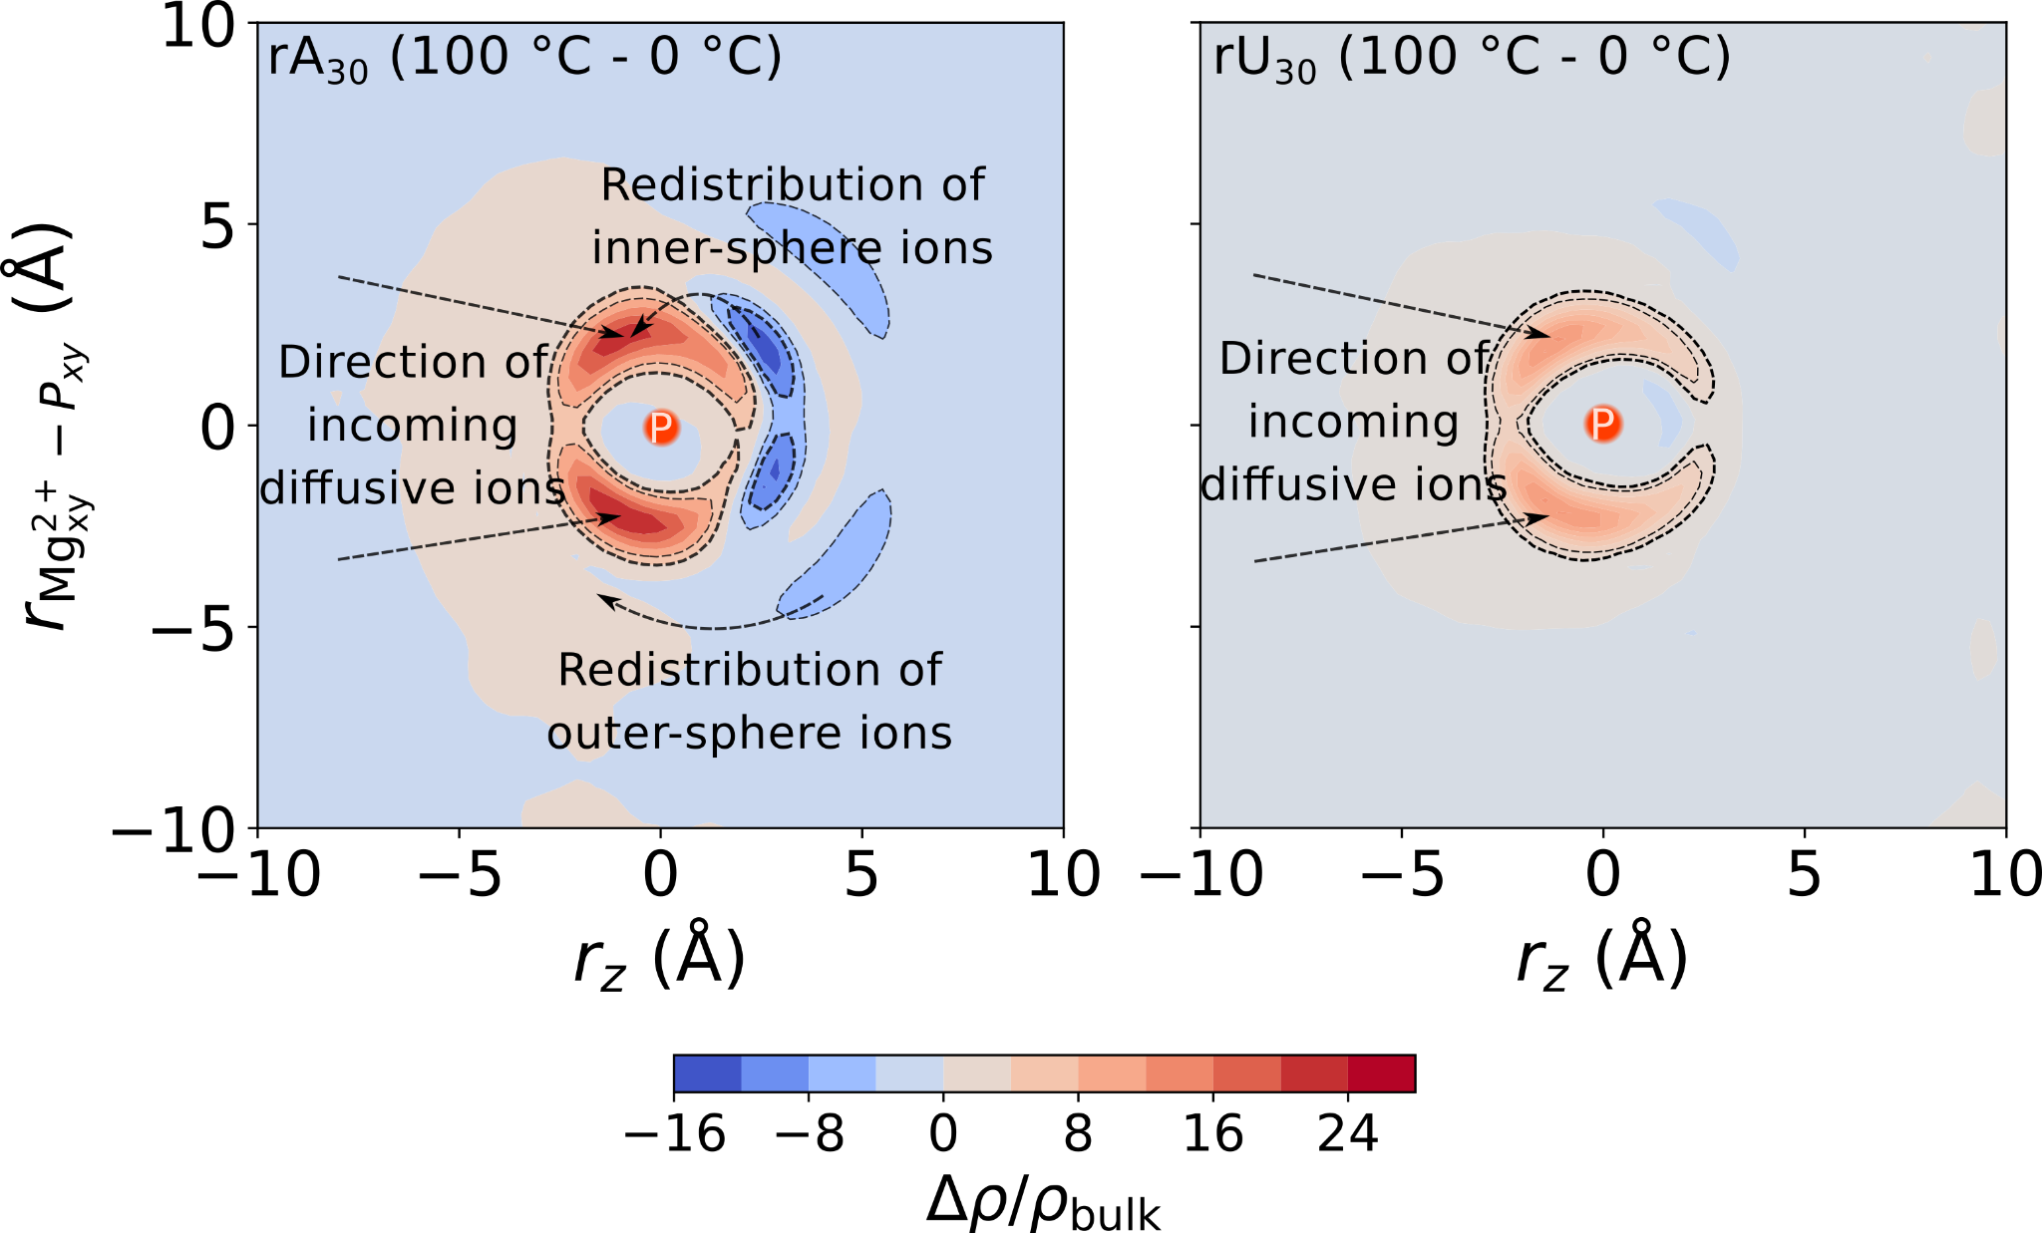
ssRNAs Ion Atmosphere Collapse at High Temperature
Error bars showing the standard deviation

Slide 14
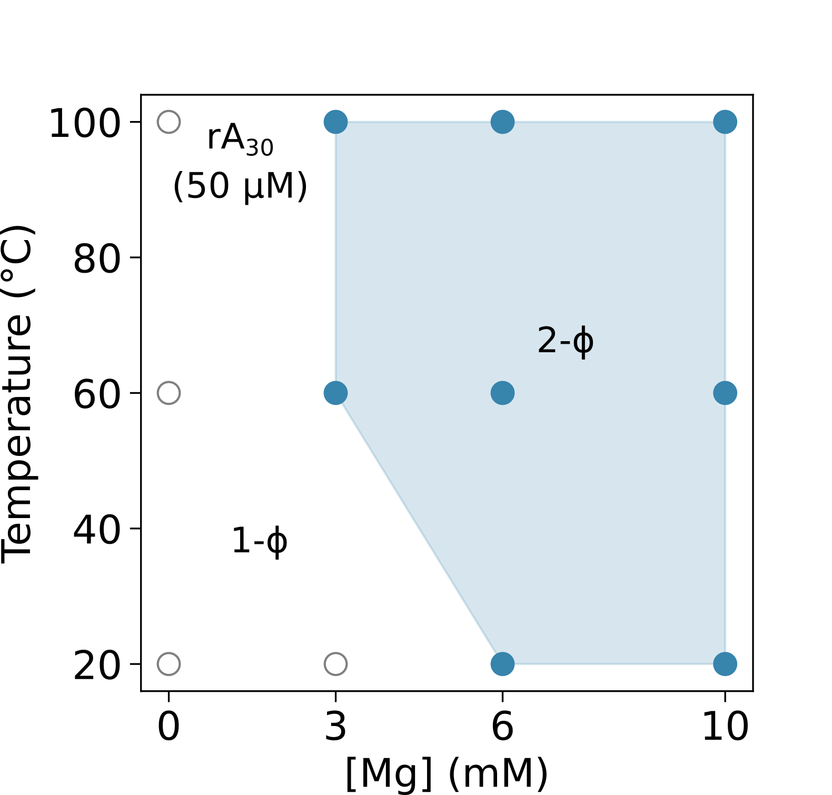
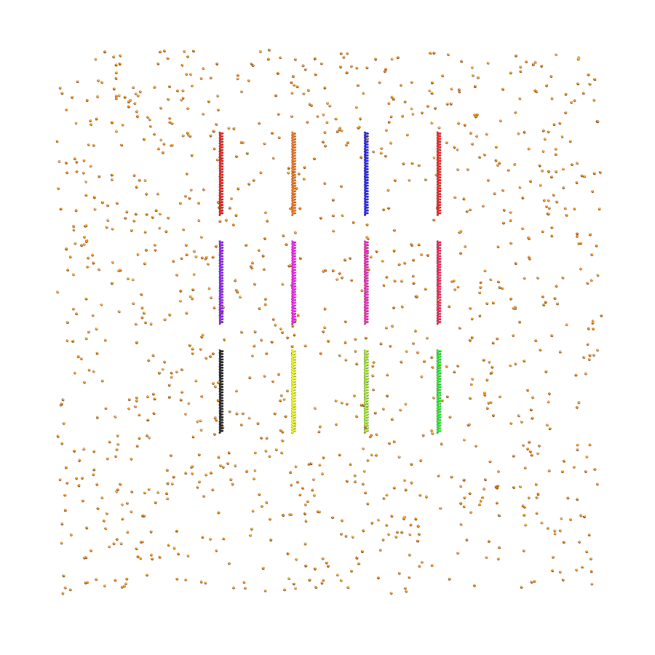
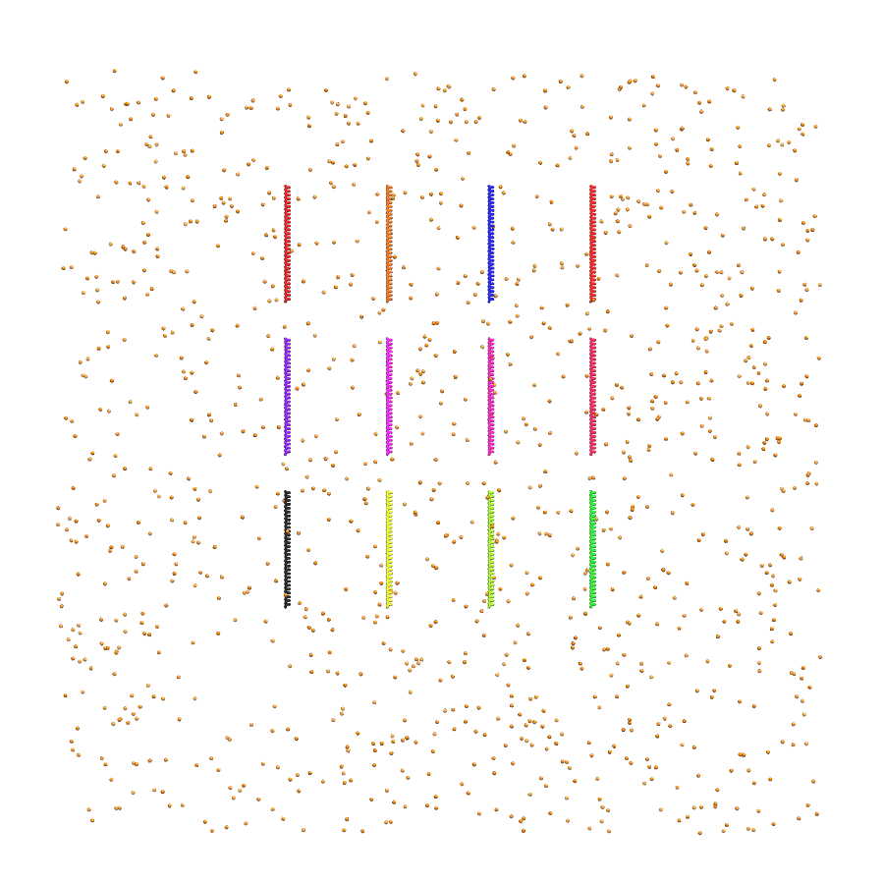
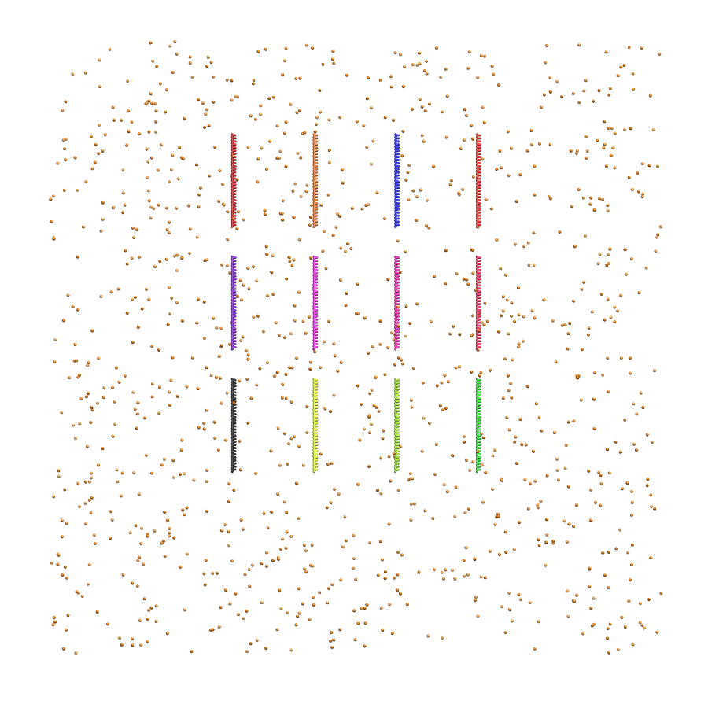
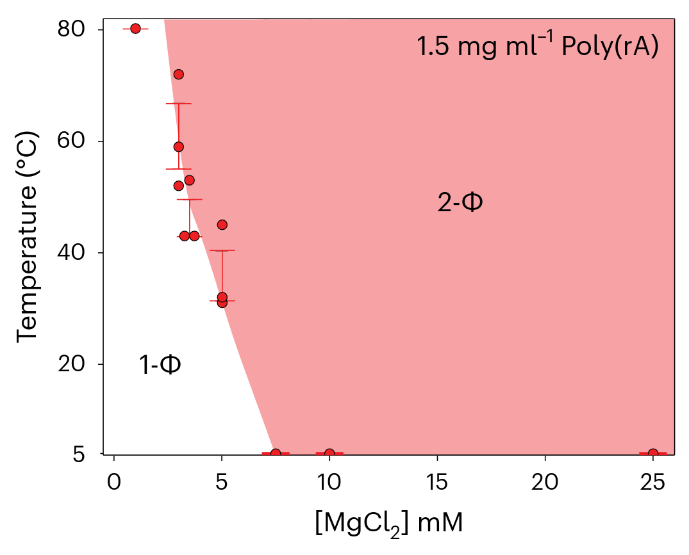
Phase Separation with Lower Critical Solution Temperatures
Simulation
20 °C
60 °C
100 °C
Exp.

Slide 15
Conclusions
ssRNA chains compact as diffusive ions migrate inward and form inner-sphere coordination with the phosphate backbone.
Chain compaction and increased inner-sphere ion binding drive lower-critical solution temperature (LCST)-type phase separation.
RNA phase separation at higher temperatures may be functionally relevant for RNA catalysis in organisms that thrive under extreme conditions.
What roles do chain flexibility and ion dynamics play in modulating RNA reactivity and condensate behavior at elevated temperatures?

Slide 16
Conclusions
ssRNA chains compact as diffusive ions migrate inward and form inner-sphere coordination with the phosphate backbone.
Chain compaction and increased inner-sphere ion binding drive lower-critical solution temperature (LCST)-type phase separation.
RNA phase separation at higher temperatures may be functionally relevant for RNA catalysis in organisms that thrive under extreme conditions.
What roles do chain flexibility and ion dynamics play in modulating RNA reactivity and condensate behavior at elevated temperatures?

Slide 17
Conclusions
ssRNA chains compact as diffusive ions migrate inward and form inner-sphere coordination with the phosphate backbone.
Chain compaction and increased inner-sphere ion binding drive lower-critical solution temperature (LCST)-type phase separation.
RNA phase separation at higher temperatures may be functionally relevant for RNA catalysis in organisms that thrive under extreme conditions.
What roles do chain flexibility and ion dynamics play in modulating RNA reactivity and condensate behavior at elevated temperatures?

Slide 18
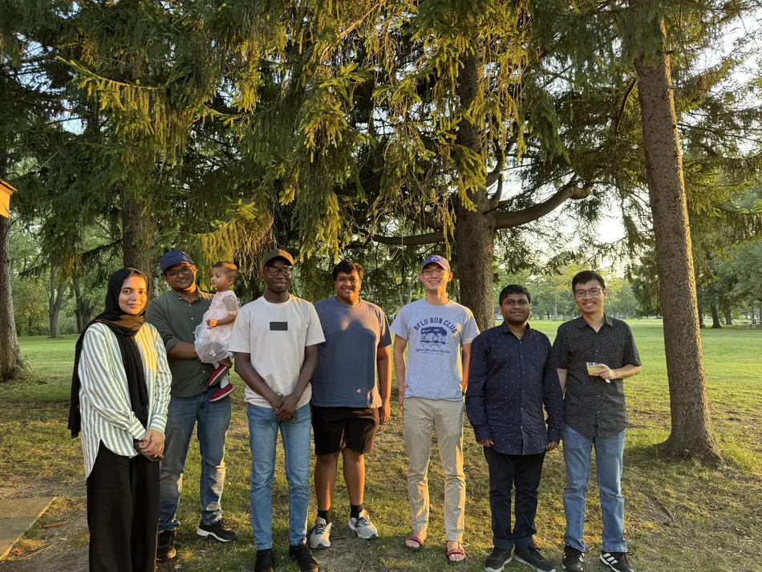
Acknowledgements
BioSim Lab @ UB
Hung Nguyen
Lipika Baidya
Hiranmay Maity
Dibya Mohanta
Samia Noor
Lipika Baidya
Ishola Abeeb Akinwumi
Ahmed Aqeel Mohamed Akbar
MDAnalysis Travel Grant
UB Center for Computational Research
UB Research Foundation

